Slide 1

IN432
Advanced Web Programming

Slide 2
Hypertext
Text with links to other text
  Click on links takes you somewhere else
Web adapted the idea, link specification:
  Uniform Resource Locators (URL) - Provided names for web content
<a href="https://en.wikipedia.org/wiki/URL">URL</a>

Slide 3
Parts of an URL
http://host.company.com:80/a/b/c.html?user=Alice&year=2008#p2
Scheme (http:): identifies protocol used to fetch the content.
Host name (host.company.com): name of a machine to connect to.
Server's port number (80): allows multiple servers to run on the same machine.
Hierarchical portion (/a/b/c.html): used by server to find content.
Query parameters (?user=Alice&year=2008): provides additional parameters
Fragment (#p2): Have browser scroll page to fragment (html: p2 is anchor tag)
  Used on the browser only; not sent to the server.

Slide 4
URL: schemes (e.g. http)
http: is the most common scheme; it means use the HTTP protocol
https: is similar to http: except that it uses SSL encryption
file: means read a file from the local disk
websocket: means create a TCP connection
mailto: means open an email program composing a message
  There are many (~350) other schemes: https://www.iana.org/assignments/uri-schemes/
    Example: mongodb: points to a MongoDB database

Slide 5
URL: Hierarchical portion (/a/b/c.html)
Passed to the web server for interpretation. Early web servers:
  Path name for a static HTML file.
  Path name of a program that will generate the HTML content (e.g., foo.php).
Web server programmed with routing information
  Map hierarchical position to function to be performed and possibly the function's parameters
Application Programming Interface (API) design, Example:
  /user/create
  /user/list
  /user/0x23490
  /user/0x23433
  /user/delete/0x23433

Slide 6
Query Parameters (e.g. ?user=Alice&year=2008)
Traditionally has been to provide parameters to operation:
http://www.company.com/showOrder.php?order=4621047

Slide 7
Links
Browser maintains a notion of current location (i.e. URL)
Links: content in a page which, when clicked on, causes the browser to go to URL
Links are implemented with the <a> tag:
<a href="http://www.company.com/news/2009.html">2009 News</a>

Slide 8
Different types of links
Full URL: <a href="http://www.xyz.com/news/2009.html">2009 News</a>
Absolute URL: <a href="/stock/quote.html"> same as http://www.xyz.com/stock/quote.html
Relative URL (intra-site links): <a href="2008/March.html">
same as http://www.xyz.com/news/2008/March.html
Define an anchor point (a position that can be referenced with # notation):
<a name="sec3">
Go to a different place in the same page: <a href="#sec3">

Slide 9
Uses of URLs
Loading a page: type the URL into your browser
Load a image:
<img src="..." />
Load a stylesheet:
<link rel="stylesheet" type="text/css" href="...">
Embedded a page:
<iframe src="http://www.google.com">

Slide 10
URL Encoding
What if you want to include a punctuation character in a query value?
http://www.stats.com/companyInfo?name=C&H Sugar
Any character in a URL other than A-Z, a-z, 0-9, or any of -_.~ must be represented as %xx, where xx is the hexadecimal value of the character:
http://www.stats.com/companyInfo?name=C%26H%20Sugar
Escaping is a commonly used technique and also a source of errors

Slide 11
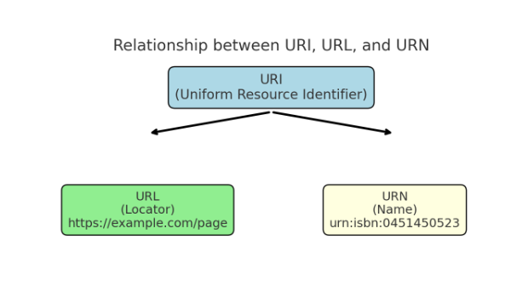
URI VS URL

Slide 12
Anchors
To create the anchor itself, type <A NAME=“anchor name”>label</A> at the point in the Web page where you want the user to jump to
To create the link, type <A HREF=“#anchor name”>label</A> at the point in the text where you want the link to appear

Slide 13
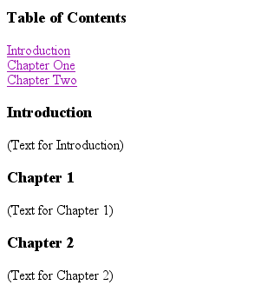
Example: Anchor
<A HREF="#chap2">Chapter Two</A><BR>
Link
<A NAME="chap2">Chapter 2 </A>
Anchor

Slide 14
Tables
Tables can be used to display rows and columns of data, create multi-column text, captions for images, and sidebars
The <TABLE> tag is used to create a table; the <TR> tag defines the beginning of a row while the <TD> tag defines the beginning of a cell

Slide 15
Adding a Border
The BORDER=n attribute allows you to add a border n pixels thick around the table
To make a solid border color, use the BORDERCOLOR=“color” attribute
To make a shaded colored border, use BODERCOLORDARK=“color” and BORDERCOLORLIGHT=“color”

Slide 16

Creating Simple Table
<TABLE BORDER=10>
<TR>
<TD>One</TD>
<TD>Two</TD>
</TR>
<TR>
<TD>Three</TD>
<TD>Four</TD>
</TR>
</TABLE>
Here’s how it would look on the Web:

Slide 17
Adjusting the Width
When a Web browser displays a table, it often adds extra space. To eliminate this space use the WIDTH =n attribute in the <TABLE> and <TD> tags
Keep in mind - a cell cannot be smaller than its contents, and if you make a table wider than the browser window, users will not be able to see parts of it.

Slide 18
Centering a Table
There are two ways to center a table
  Type <TABLE ALIGN=CENTER>
  Enclose the <TABLE> tags in opening and closing <CENTER> tags

Slide 19
Wrapping Text around a Table
It is possible to wrap text around a table. This technique is often used to keep images and captions together within an article.
To wrap text around a table, type <TABLE ALIGN = LEFT> to align the table to the left while the text flows to the right.
Create the table using the <TR>, <TD>, and </TABLE> tags as you normally would

Slide 20
Adding Space around a Table
To add space around a table, use the HSPACE=n and VSPACE=n attributes in the <TABLE> tag
Example:
  <TABLE HSPACE=20 VSPACE=20>

Slide 21
Spanning Cells Across Columns
It is often necessary to span one cell across many columns. For example, you would use this technique to span a headline across the columns of a newspaper article.
To span a cell across many columns, type <TD COLSPAN=n>, where n is the number of columns to be spanned

Slide 22
Spanning Cells Across Rows
To span a cell across many rows, type <TD ROWSPAN=n>, where n is the number of rows

Slide 23
Aligning Cell Content
By default, a cell’s content are aligned horizontally to the left and and vertically in the middle.
Use VALIGN=direction to change the vertical alignment, where “direction” is top, middle, bottom, or baseline
Use ALIGN=direction to change the horizontal alignment where “direction” is left, center, or right

Slide 24
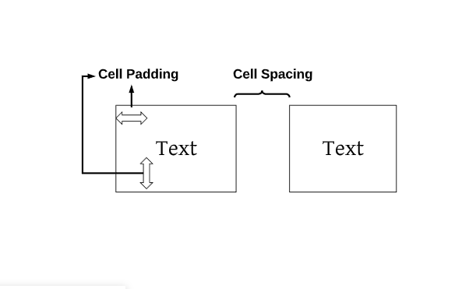
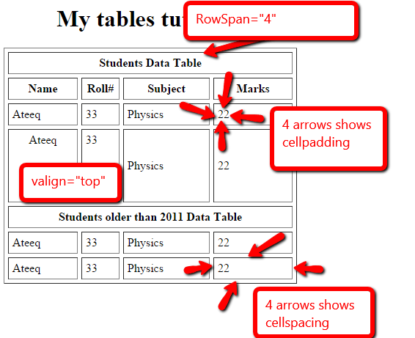
Controlling Cell Spacing
Cell spacing is the space between cells while cell padding is the space around the contents of a cell
To control both types of spacing, use the CELLSPACING =n and CELLPADDING=n attributes in the <TABLE> tag
Example:
<table width ="100% height = "100 %" border ="13" style="border-top-color:#00cc0e ; border-bottom-color:#ccbb00 ; border-left-color:#cc3e00 ;border-right-colspacing = "10" cellspacing = "30" cellpadding = "3">

Slide 25
Changing a Cell’s Color
To change a cell’s color, add the BGCOLOR=“color” attribute to the <TD> tag
Example:
  <TD BGCOLOR=“blue”>

Slide 26
Dividing Your Table into Column Groups
You can divide your table into two kinds of column groups: structural and non-structural.
Structural column groups control where dividing lines are drawn; Non-structural groups do not
Both let you format an entire column of cells at once

Slide 27
Column Groups
To create structural column groups, type <COLGROUP SPAN=n> after the <TABLE> tag, where n is the number of columns in the group
To create non-structural column groups, type <COL SPAN=n>, where n is the number of columns in the group
Example
https://www.w3schools.com/tags/tag_colgroup.asp

Slide 28
Dividing Table into Horizontal Sections
You can also create a horizontal section consisting of one or more rows. This allows you to format the rows all at once
To create a horizontal section, type <THEAD>, <TBODY>, or <TFOOT> before the first <TR> tag of the section
Netscape does not support these tags

Slide 29
Controlling Line Breaks
Unless you specify otherwise a browser will divide the lines in a cell as it sees fit.
The NOWRAP attribute placed within the <TD> tag forces the browser to keep all the text in a cell on one line
Example:
  <TD NOWRAP>Washington, D.C.

